Slide 1
Monetary Policy
1
Monetary policy
Objectives of Monetary Policy
Instruments of Monetary Policy

Slide 2
Monetary Policy
Dr. RAZIA KHATUN
PROFESSOR
DEPT. OF HUMANITIES.
KUET

Slide 3
Monetary Policy
Monetary policy is an economic policy that manages the size and growth rate of the money supply in an economy. It is a powerful tool to regulate macroeconomic variables such as inflation and unemployment. It is a policy which employs central bank’s control over the supply, cost and use of money as an instrument achieving the certain objectives of economic policy.

Slide 4
Monetary Policy
Since the common objectives of economic policy are the attainment of full employment, price stability, balance of payments equilibrium and rapid economic growth, the effectiveness of monetary policy will depend upon the degree to which it succeeds in achieving these objectives.

Slide 5
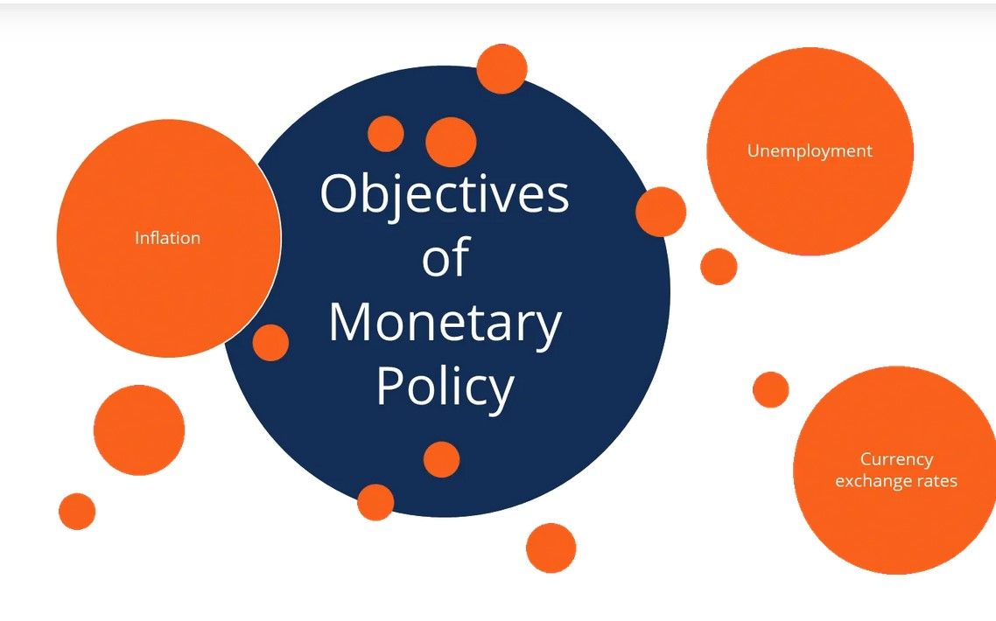
Objectives of Monetary Policy

Slide 6
Objectives of Monetary Policy
The primary objectives of monetary policies are the management of inflation or unemployment and maintenance of currency exchange rates.
1. Inflation
Monetary policies can target inflation levels. A low level of inflation is considered to be healthy for the economy. If inflation is high, a contractionary policy can address this issue.

Slide 7
2. Unemployment
Monetary policies can influence the level of unemployment in the economy. For example, an expansionary monetary policy generally decreases unemployment because the higher money supply stimulates business activities that lead to the expansion of the job market.

Slide 8
3. Currency exchange rates
Using its fiscal authority, a central bank can regulate the exchange rates between domestic and foreign currencies. For example, the central bank may increase the money supply by issuing more currency. In such a case, the domestic currency becomes cheaper relative to its foreign counterparts.

Slide 9
Instruments of Monetary Policy
Central banks use various tools to implement monetary policies. The widely utilized policy tools include:
i) Open market operations;
ii) Changes in the minimum legal cash reserves ratio; and
iii) Interest rate adjustment

Slide 10
Open market operations
The central bank can either purchase or sell securities issued by the government to affect the money supply. For example, central banks can purchase government bonds. As a result, banks will obtain more money to increase the lending and money supply in the economy.

Slide 11
Change reserve requirements
Central banks usually set up the minimum amount of reserves that must be held by a commercial bank. By changing the required amount, the central bank can influence the money supply in the economy. If monetary authorities increase the required reserve amount, commercial banks find less money available to lend to their clients, and thus, money supply decreases.

Slide 12
Change reserve requirements
Commercial banks can’t use the reserves to make loans or fund investments into new businesses. Since it constitutes a lost opportunity for the commercial banks, central banks pay them interest on the reserves. The interest is known as IOR or IORR (interest on reserves or interest on required reserves).

Slide 13
Interest rate adjustment
A central bank can influence interest rates by changing the discount rate. The discount rate (base rate) is an interest rate charged by a central bank to banks for short-term loans. For example, if a central bank increases the discount rate, the cost of borrowing for the banks increases. Subsequently, the banks will increase the interest rate they charge their customers.

Slide 14
Interest rate adjustment
Thus, the cost of borrowing in the economy will increase, and the money supply will decrease.

Slide 15
THANKS

